Slide 1



Residential Location Choices and Household Activity Engagement
1/14/2013
Roger Chen, Steven Gehrke, Yunemi Jiang, Jenny Liu and Kelly Clifton
Oregon
Modeling
Collaborative

Slide 2
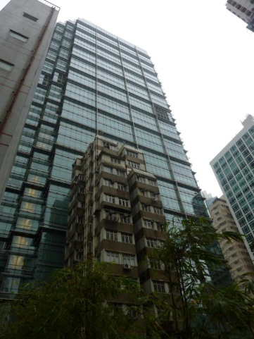
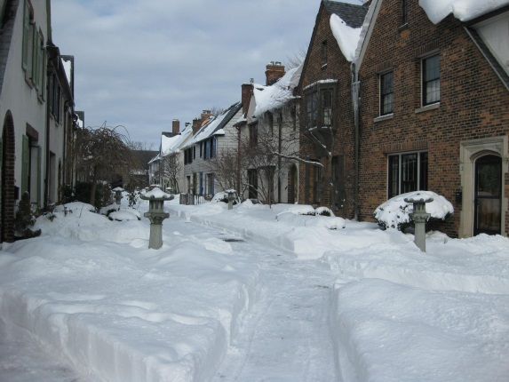


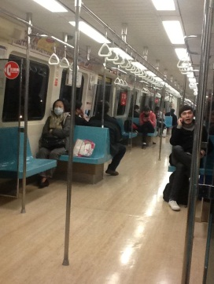
Introduction
A relationship exists between
where we live and what we do
Different Location type choices
Lead to different activity engagement
What is the relationship between
where we live and how households
spend their time?

Slide 3
Overview of Study
This study is concerned with loocation at ther elatopnsiip beween where wee vive and how we spend out time
Data on Activity engagement is nucours; as a the alocation of time is distilled
Estimate models of choice to look at connection

Slide 4
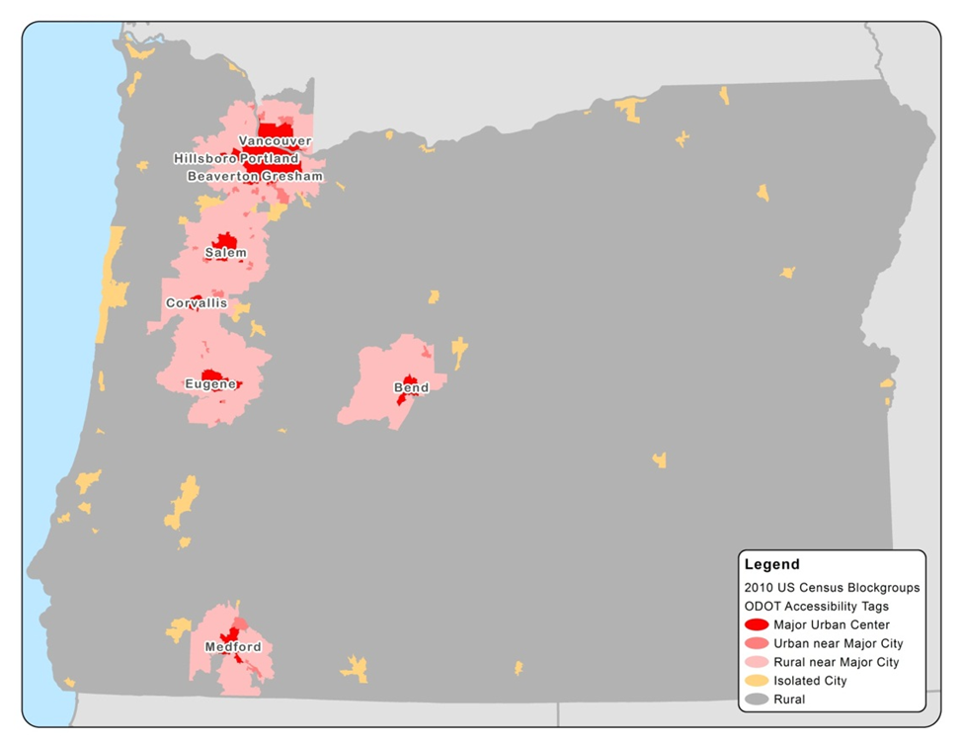
Study Area and Distribution of Residential Area-Types

Slide 5
Area-Type Distribution of Households in Sample
Rural
Household is more than two miles away from 2,500 people and more than 15 miles away from 50,000 people.
Major Urban Center
Households within five miles of 50,000 people and within a mile of 2,500 people, where the majority of households are within an MPO.
Isolated City
Household is within two miles of 2,500 people and is more than 15 miles away from 50,000 people.
Rural near Major City
Household that is immediately surrounded by an area of less than 2,500 people, but is within 15 miles of 50,000 people.
Urban near Major City Household with 2,500 people within one mile of the residential location, that is also within 15 miles of 50,000 people.

Slide 6
Tenure-Housing Type Distribution of Sample
Housing Tenure
Rent
Rent
Own
Own
16.36%
83.64%
MF
DPLX
Single-
Family
Unit
Duplex
Unit
Multi-
Family
Unit
Single-
Family
Unit
Duplex
Unit
Multi-
Family
Unit
SF
SF
96.7%
1.09%
2.21%
36.65
13.17%
50.18%
DPLX

Slide 7
Why we segment into lifestyle classes
Control for heterogeneity
Based on classifications found in the literature

Slide 8
Household Segmentation
Household Size
Single Households
Non-Single Households
Age >=
65 yrs.
Age <
65 yrs.
Related
Household
Unrelated
Household
Segment 1:
Single, >=65 yrs.
Segment 2:
Single, < 65 yrs.
with Children
(0<=Age<=17 yrs.)
No Children
(0<=Age<=17 yrs.)
Num. Adult =1
Num. Adult >1
HH Members
Age >= 65 yrs.
HH Members
Age < 65 yrs.
Segment 3:
Unrelated
Segment 4:
Single Adult
With Children
Segment :5
Related Adults
>1With Children
Segment :6
All Adults >= 65 yrs.
Segment :7
Related Adults
Household (<65 yrs.)

Slide 9
Descriptive Statistics of Lifecycle Segments
Original Slide

Slide 10
Household Lifecycle Stage from the OHAS Sample

Slide 11
Lifecycle Segments within the OHAS Sample

Slide 12
Lifecycle Segments within the OHAS Sample

Slide 13
Lifecycle Segments within the OHAS Sample

Slide 14
Lifecycle Segments within the OHAS Sample

Slide 15
Lifecycle Segments within the OHAS Sample

Slide 16
Lifecycle Segments within the OHAS Sample

Slide 17
Slide about Factor Analysis

Slide 18
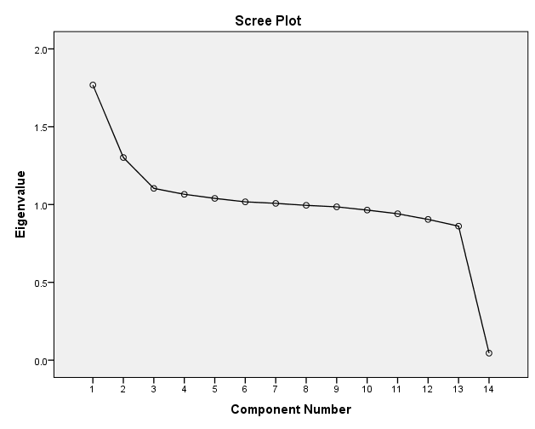
Principal Component Extraction
7 Factors
59.3% Variance Explained
Cut-off at λ < 1.0

Slide 19
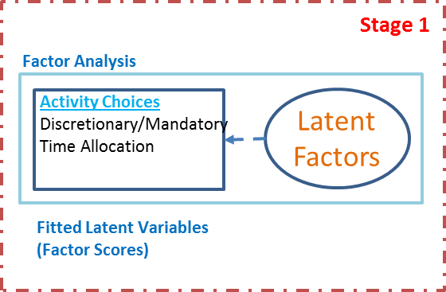
Factor Analysis of Time Allocated per Household
Original Slide
Factor 1 (Work): Strongly and positively correlated
with work activities and negatively correlated with
in-home activity allocation.
Factor 2 (Routine Out-of-Home Activities): strongly
correlated with activity types that are suggestive
of routine activity patterns or activities.
Factor 3 (School Travel): This third factor is characterized
strongly by school related activities. Although passenger
pick-up/drop-off is not specifically identified as being
student-related (student pick-up/drop-off), the bundling
with school activities suggests this may be the case.
Factor 4 (Eating and Recreation): general out-of-home social
activities that are strongly correlated with eating and recreation.
Factor 5 (Work with Errands): bundling between work and
out-of-home errands; suggests that the work
activity may be an anchoring activity in trip-chaining.
Factor 6 (Specialty Shopping and Civic/Religious): bundling between
civic/religious activities and specialty shopping.
Factor 7 (Personal Activities and Civic/Religious): similar to the sixth
factor and suggests a bundling of civic/religious activities
with personal activities.

Slide 20
Factor Label | Percent Variance Explained | Influencing Activities (Time Allocated per Household – BOLD: Factors > 0.6)
Work (out-of-home) | 12.6% | (-) Home (+) Working from Home (+) Work/Work-related
Routine Out-of-Home Activities | 9.3% | (-) Work/Work-related (+) Routine Shopping, HH Errands (+) Personal Business (+) Eating (Out-of-Home) (+) Visit
School and School-Related Travel | 7.9% | (-) Work/Work-Related (+) Transfer/Drop-off/Pick-up (Travel) (+) Class/Class-Related (School)
Eating and Recreation | 7.6% | (+) Recreation/Entertainment (+) Eating (Out-of-Home) (-) Healthcare (-) Visit
Work at Home with Errands | 7.4% | (-) Working at Home (+) Work/Work-related (+) Transfer/Drop-off/Pick-up (Travel) (+) Eating (Out-of-Home)
Specialty Shopping and Civic/Religious | 7.3% | (+) Civic/Religious (+) Transfer/Drop-off/Pick-up (Travel) (+) Special Shopping
Personal Activities and Civic/Religious | 7.2% | (+) Personal Business (-) Working at Home (+) Civic/Religious
Notes:
(Costello & Osborne, 2005) BOLD ARE >0.6
>.8 – strong
>.7 – moderate
>.4 - low

Slide 21
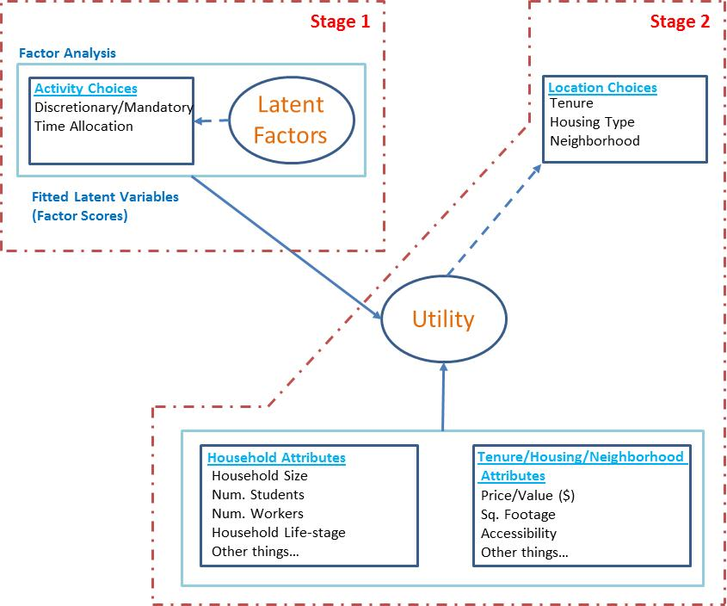
Model Specification
ɛ

Slide 22
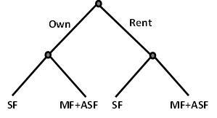

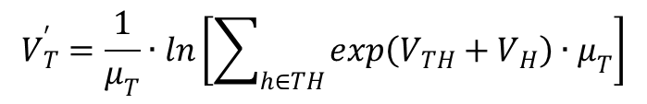
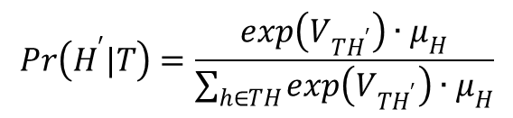
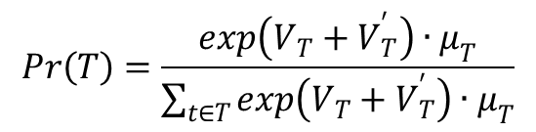


Original Slide
Model Specification
μ(t)
μ(h)
ɛ
$$Pr\left(T\right)=\frac{exp\left(V_{T}+V_{T}^{′}\right)∙μ_{T}}{\sum_{t∈T}{exp\left(V_{T}+V_{T}^{′}\right)∙μ_{T}}}$$
$$Pr\left(H^{′}|T\right)=\frac{exp\left(V_{TH^{′}}\right)∙μ_{H}}{\sum_{h∈TH}{exp\left(V_{TH^{′}}\right)∙μ_{H}}}$$
$$U_{TH}=V_{TH}+V_{T}+V_{H}+ε_{TH}+ε_{T}+ε_{H}$$
Assumptions:
$$V_{T}^{′}=\frac{1}{μ_{T}}∙ln\left[\sum_{h∈TH}{exp\left(V_{TH}+V_{H}\right)∙μ_{T}}\right]$$
$$Var\left(ε_{H}\right)=0$$
$ε_{T}\sim iid Gumbel(0,$ $μ_{T}$)
$ε_{TH}\sim iid Gumbel(0,$ $μ_{H}$)

Slide 23
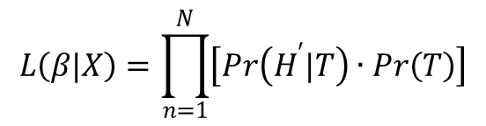

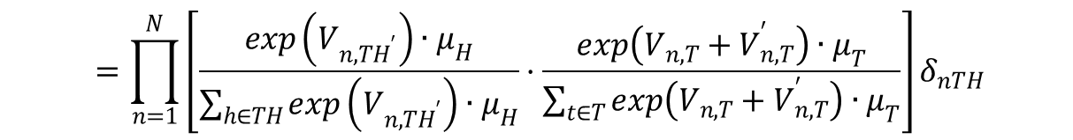
Original Slide
Model Estimation
Likelihood Function
(basically you want to optimize this function w.r.t the betas)
$$L\left(β|X\right)=\prod_{n=1}^{N}{\left[Pr\left(H^{′}|T\right)∙Pr\left(T\right)\right]}$$
$$=\prod_{n=1}^{N}{\left[\frac{exp\left(V_{n,TH^{′}}\right)∙μ_{H}}{\sum_{h∈TH}{exp\left(V_{n,TH^{′}}\right)∙μ_{H}}}·\frac{exp\left(V_{n,T}+V_{n,T}^{′}\right)∙μ_{T}}{\sum_{t∈T}{exp\left(V_{n,T}+V_{n,T}^{′}\right)∙μ_{T}}}\right]}δ_{nTH}$$
$$δ_{nTH}=$$
1 if combination TH is chosen by observation n and 0 otherwise.
N = Total Number of Households
A Full- Information Maximum Likelihood (FIML) Procedure was used…
For identification, the scale parameter for tenure was set to 1;
the own/single-family combination was used as the base;
the retired household segment was used as the base.

Slide 24
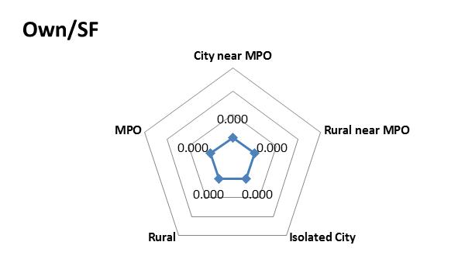
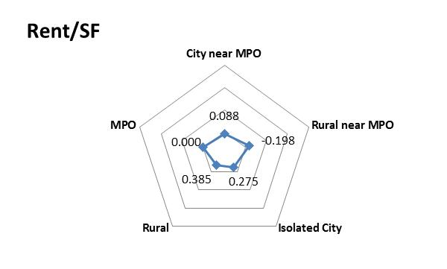
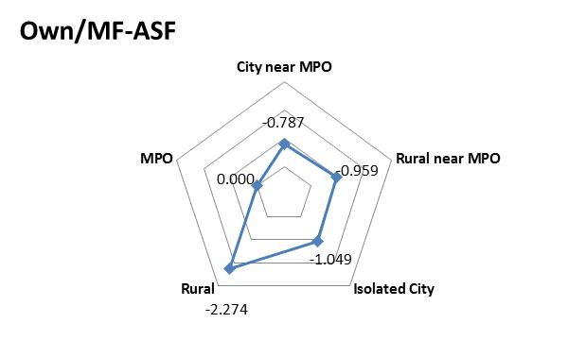
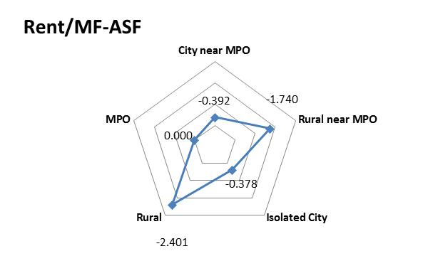
Original Slide
Estimation Results: Coefficients on Accessibility
HH are more likely to rent
single-family homes in rural,
isolated and cities near
MPOs relative to
households in MPOs.
HH are less likely to rent
multi-family and attached
single-family in areas outside
of MPOs.
HH are less likely to own
multi-family and attached
single-family in areas outside
of MPOs; this is least likely in rural areas
In general in rural areas, HHs are more likely
To own a single family unit;

Slide 25
NOTE: I’m using this as an “introduction slide”…
“Remember the area-types we discussed earlier? Here’s how they fair in the model…”
Estimation Results: Area-Type Model Coefficients

Slide 26
Estimation Results: Area-Type Model Coefficients
Base case

Slide 27
Estimation Results: Area-Type Model Coefficients
HH are more likely to rent
single-family homes in rural,
isolated and cities near MPOs relative to households in MPOs.

Slide 28
Estimation Results: Area-Type Model Coefficients
HH are less likely to own
multi-family and attached
single-family in areas outside
of MPOs; this is least likely in rural areas

Slide 29
Estimation Results: Area-Type Model Coefficients
HH are less likely to rent
multi-family and attached
single-family in areas outside of MPOs.
In general in rural areas, HHs are more likely to own a single family unit.

Slide 30
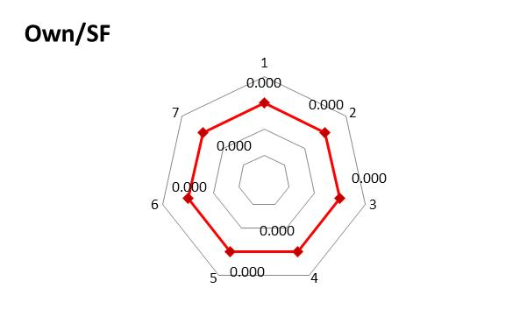
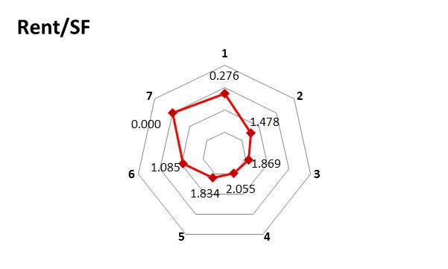
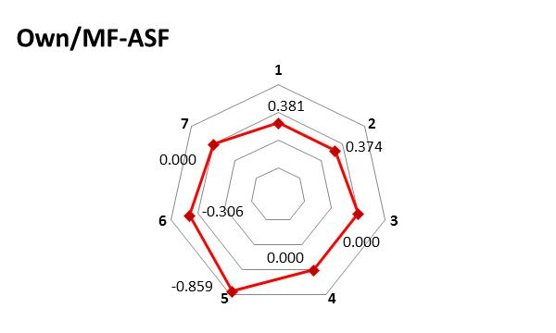
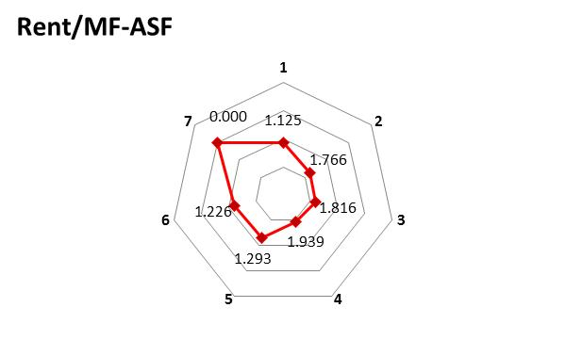
Original Slide
Estimation Results: Coefficients on Lifestyle Segments
Relative to retired couples,
All segments are more likely to
Rent a SF home.
Relative to retired couples,
All segments are more likely to
Rent a SF home.
In general, retired households
Are less likely to rent relative to
Owning a SF.
Single Adult >=65
Single Adult <65 and >=18
Non-related Household
Single Parents with Children
Parents with Children
Related Adults no Children, <65
Related Adults no Children, >=65
W.R.T owning MF-ASF, single adults
are the most likely segment; the least
likely are parents with children.

Slide 31
Lifecycle Segments within the OHAS Sample

Slide 32
Estimation Results: Lifecycle Model Coefficients
Base case

Slide 33
Estimation Results: Lifecycle Model Coefficients
Relative to retired couples, all segments are more likely to rent a SF home.

Slide 34
Estimation Results: Lifecycle Model Coefficients
Single adults are the most likely segment to own a Multi-Family/Attached Single-Family home. The least likely are parents with children.

Slide 35
Estimation Results: Lifecycle Model Coefficients
Single parents with Children are the most likely segment to rent a Multi-Family/Attached Single-Family home. The least likely are older adults (with or without kids).

Slide 36
Original Slide
Estimation Results: Other Coefficients
F4 = Spending more time on out-of-home
Eating and recreation negatively affects the
Likelihood of renting.
F6 = Specialty Shopping w/Religious-Civic has a
positive impact on renting SF units for
Single retired adults and Couples without children
F3 and F5 = Spending more time on school related
activities and work w/errands positively impacts
the likelihood of renting a MF or DSF.
F2 = Spending more time on routine out-of-home
Activities reduces the likelihood of renting a SF unit.
Weak (but statistically significant) correlation among alternatives in the same nest….

Slide 37
Factor Label | Percent Variance Explained | Influencing Activities (Time Allocated per Household – BOLD: Factors > 0.6)
Work (out-of-home) | 12.6% | (-) Home (+) Working from Home (+) Work/Work-related
Routine Out-of-Home Activities | 9.3% | (-) Work/Work-related (+) Routine Shopping, HH Errands (+) Personal Business (+) Eating (Out-of-Home) (+) Visit
School and School-Related Travel | 7.9% | (-) Work/Work-Related (+) Transfer/Drop-off/Pick-up (Travel) (+) Class/Class-Related (School)
Eating and Recreation | 7.6% | (+) Recreation/Entertainment (+) Eating (Out-of-Home) (-) Healthcare (-) Visit
Work at Home with Errands | 7.4% | (-) Working at Home (+) Work/Work-related (+) Transfer/Drop-off/Pick-up (Travel) (+) Eating (Out-of-Home)
Specialty Shopping and Civic/Religious | 7.3% | (+) Civic/Religious (+) Transfer/Drop-off/Pick-up (Travel) (+) Special Shopping
Personal Activities and Civic/Religious | 7.2% | (+) Personal Business (-) Working at Home (+) Civic/Religious
Notes:
(Costello & Osborne, 2005) BOLD ARE >0.6
>.8 – strong
>.7 – moderate
>.4 - low

Slide 38
NOTE: I took a stab at interpretation. Please check me. I still haven’t taken a discrete choice class so my knowledge base is weak if not non-existent.
Estimation Results: Time-Allocation Factors
Household variation in the Time-Allocation Factor Scores “Work” or “Personal Activity with Civic Responsibilities” activities was not a significant variable in explaining differences in either tenure or housing structure choice.
When comparing variation across any Time-Allocation Factor Scores, there was also no significant difference between propensities to own a single-family or multi-family/attached single-family homes.
Notes:
(Costello & Osborne, 2005) BOLD ARE >0.6
>.8 – strong
>.7 – moderate
>.4 - low

Slide 39
Estimation Results: Time-Allocation Factors
Households with larger time-allocation scores for routine out-of-home activities, then to be slightly less likely to rent a single-family home, then to own their own home or rent a multi-family/attached single-family home.
Notes:
(Costello & Osborne, 2005) BOLD ARE >0.6
>.8 – strong
>.7 – moderate
>.4 - low

Slide 40
Estimation Results: Time-Allocation Factors
Households with larger scores related to school activity time, also tend to be more likely to rent multi-family or attached single-family housing types.
Notes:
(Costello & Osborne, 2005) BOLD ARE >0.6
>.8 – strong
>.7 – moderate
>.4 - low

Slide 41
Estimation Results: Time-Allocation Factors
Households with larger eating out- and recreation-type activity scores, also tend to be much less likely to rent.
They tend to be even more likely to rent single-family housing types.
Notes:
(Costello & Osborne, 2005) BOLD ARE >0.6
>.8 – strong
>.7 – moderate
>.4 - low

Slide 42
Estimation Results: Time-Allocation Factors
Households with a greater amount of work-related activity, tend to rent multi-family or attached single-family housing types more.
Notes:
(Costello & Osborne, 2005) BOLD ARE >0.6
>.8 – strong
>.7 – moderate
>.4 - low

Slide 43
NOTE: My interpretation leaves the interacted coefficients for Rent/SF x lifecycle 2 or 6 to be identified separately than “all lifecycles”. Should these be displayed in sum?
e.g. B rent/SF (*1) + B rent/SF x lifecycle 2 (*1)
I’m not clear how interacted variables should be presented when discussing overall propensities in mode choice models…
Estimation Results: Time-Allocation Factors
In general, households who spend larger amounts of their time doing specialty shopping or participating in civic/religious activities, tend to be less likely to rent a single-family home.
Single adults (age: 18-65) or related adults without children (age: < 65) who spend greater amounts of time doing these things, have a greater likelihood of renting a single-family home.
This slide is messy. I’m not really liking the double radial graph… Not sure yet
Notes:
(Costello & Osborne, 2005) BOLD ARE >0.6
>.8 – strong
>.7 – moderate
>.4 - low

Slide 44
Estimation Results: Time-Allocation Factors
Thoughts about results for Time-allocation factors?
NOTE: Why are we not getting a whole lot of results from using the time-allocation activity factors? Is it because we factored time across all lifecycle stages, instead of factoring within stages? Would that make a difference? How about looking at the factor analysis and checking how much explanation of variance these factors provide?
Notes:
(Costello & Osborne, 2005) BOLD ARE >0.6
>.8 – strong
>.7 – moderate
>.4 - low

Slide 45
Conclusions
NOTE: Improve conclusions. Maybe our outcome says something about using a FA on time allocation as a proxy instead of an actual model. How might this be applicable to practicing modelers? What are we not able to capture YET.
In rural areas, you are less likely to see rentals and old people. In fact, in general retired.
Retired households are less likely to rent, but more likely to located in urban areas.
Households with children are less likely to rent MF or ASF homes.

Slide 46
Extensions for Future Work
Incorporate Stated-Preference (SP) responses
Do away with the two-stage approach
Integrate price index model
Improve process capturing household time allocation

